Slide 1
Chapter 2
Operating Systems Overview

Slide 2
Operating Systems
Collection of programs that
Acts as an interface between user and the machine
Provides services to system users
Provides an environment for users to develop, debug, and maintain their programs
Allocates system resources so as to achieve their maximum utilization
The primary goal of OS is convenience of users
The secondary goal is efficient utilization of resources
OS should also have the ability to evolve

Slide 3
Abstract view of a computer system
User 1
User 2
User 3
User k
Compiler solitaire database text editor
System and application programs
Operating System
Computer Hardware

Slide 4
Operating System Services
User interface
Program development
Program execution
I/O operations
File system manipulation
System access
Communication between processes
Error detection
Resource allocation
Accounting
Protection and security
For Users’ benefit
For efficient operation of the system

Slide 5
Operating System as a Resource Manager
A computer system has the following resources:
Processor
Memory
I/O devices
Files
As a manager of these resources, the OS
Keeps track of the status of each resource
Implements a policy as to who gets what, when, and for how long
Allocates resources according to the policy
Reclaims back the resources

Slide 6
Operating System as Software
OS is a program or a collection of programs executed by the processor
Functions in the same way as ordinary computer software
Frequently relinquishes control of the processor and must depend on the processor to allow it to regain control

Slide 7
Evolution of Operating Systems
Operating systems have evolved over time due to
Changes in hardware technology
Software advances

Slide 8
Evolution of OS
The operating system development has gone through the following stages:
Early systems did serial processing
Then came simple batch systems
These were followed by multi-programmed batch systems
Time sharing systems

Slide 9
Serial processing
Early computers
No operating systems
Programmers interacted directly with hardware
Computers ran from a console with display lights, toggle switches, some form of input device, and a printer
Users had direct access to computer “one after the other”

Slide 10
Problems with serial processing
Scheduling:
Sign-up sheet to reserve computer time
Time allocation could be longer or shorter than actually needed
Setup Time
A considerable amount of time was used up in just setting up the program to run

Slide 11
Simple batch systems
Early computers were very expensive
Important to maximize processor utilization
Monitor
A control program that sequenced execution of programs
User no longer had direct access to processor
Jobs were submitted to computer operator, who batched them together, and placed them on input device
The program branched back to the Monitor when finished

Slide 12
Monitor
Monitor was resident in memory. It consisted of the following modules
Interrupt processing
Job sequencing
Device drivers
Control language interpreter
Monitor controlled sequencing of events
Monitor read in a job and gave it control of processor – instructions from user memory are executed
When job finished it returned control back to the monitor – instructions from Monitor memory are executed

Slide 13
Job Control Language (JCL)
A special language needed for providing information about the job to monitor
Typical information
Compiler or assembler to use for the program
Data associated with the program

Slide 14
Challenges in Monitor Implementation
Monitor and user program resided in the same memory. Need to protect monitor memory from user
Once a control is given to a user program, how does the monitor make sure it gets the control back
How do we distinguish whether the processor is working on a user program or in the monitor?

Slide 15
Dual mode of operation
These problems were solved by hardware support
Two modes of operations were introduced – user mode and monitor mode
Machine instructions were divided into two categories
Privileged instructions, which could only be executed in monitor mode
Non-privileged instructions could be executed in both modes of operation

Slide 16
Monitor Memory protection
The dual mode of operation provided the desired control
Monitor memory protection. The monitor usually stored in lower memory addresses.
Fence register contained the address of the location where the user programs started.
Every memory address generated by the processor was compared against this fence register
In user mode, if the processor requested for a memory address less than the value in the Fence register, a memory protection error signal is raised. The control goes back to the Monitor which terminates the erring program

Slide 17
Timer
To prevent a user job from monopolizing the processor, a timer register is used
Before giving control to a user program, the monitor sets the timer which decrements every unit of time.
If the program does not terminate before the timer goes to zero, the monitor gets a timer interrupt and the control goes to the monitor. The monitor terminates the program
The instruction that sets the value in the timer register is a privileged instruction.

Slide 18
Simple batch system overhead
Processor time alternates between execution of user programs and execution of the monitor
Some processor time is wasted by the monitor
Some portion of main memory is allocated to the monitor. This memory cannot be used by the user program
Despite loss of processor time and memory for monitor, the simple batch system improves utilization of the system by substituting slow manual control with efficient automatic control

Slide 19
Simple Batch System
In the simple batch system, one job is executed at a time.
When an I/O operation is performed, the processor waits for its completion.
I/O devices are very slow compared to processor
Suppose you are text-editing and typing in at a speed of 300 strokes per minute. This implies it takes you 200 ms to supply 1 character to the processor. If the processor takes 5 ms to process this character and has to wait for 200 ms for the next character to put in, the processor is busy only 5 ms out of every 205 ms. Thus, the processor utilization is only 5/205 = 1/41 = 0.0244 = 2.44% -- a waste of a highly valuable resource

Slide 20
Uni-programming
In a system that processes one job at a time, the processor executes instructions until it reaches an I/O operation. It then waits for the I/O operation to complete. This cycle continues till the program is terminated.
Processor utilization = (time during which processor executes)/(total time it takes to complete the program)

Slide 21
Multiprogramming
To improve processor utilization, if we can keep more than one program in memory, instead of waiting for an I/O to complete for a program, we can start executing another program, we will be increasing the processor utilization.
Need enough memory to keep many programs in memory
Need a mechanism to switch from one program to another

Slide 22
Process Execution
A typical process has the following form:
loop:
compute; // cpu-burst
perform I/O; // I/O-burst
end {loop};

Slide 23
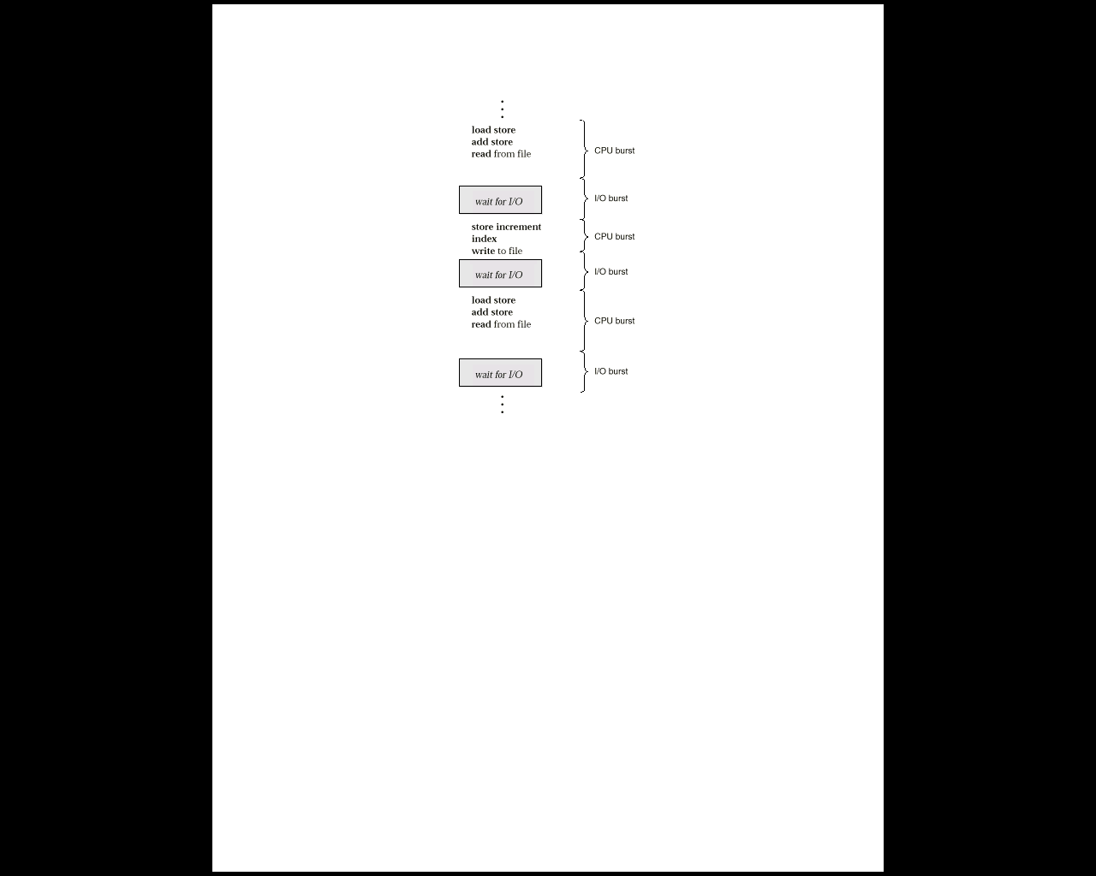
Alternating Sequence of CPU And I/O Bursts

Slide 24
Example
Consider two processes A and B;
Process A{ Process B{
repeat 50 times{ repeat 50 times{ compute; compute;
I/O; I/O;
} }
} }
For sake of simplicity, assume each activity takes 1 unit of time.

Slide 25
Uni-programming
First execute Process A, then B;
CPU
I/O
Device working on job A
Device working on job B
Device idle
It takes 200 units to complete the 2 jobs.

Slide 26
Multiprogramming
Alternatively, when A waits for I/O, let B execute on CPU, and vice versa.
CPU
I/O
Device working on Job A
Device working on Job B
Device idle
Now it takes only 101 units of time.

Slide 27
Multiprogramming
In the first case:
CPU utilization = 100/200 = 50%
I/O utilization = 100/200 = 50%
In the second case:
CPU utilization = 100/101 100%
I/O utilization = 100/101 100%

Slide 28
Multiprogramming
Multiprogramming attempts to maximize utilization of devices by providing concurrency of their operation.
Success depends on availability of a large number of jobs with different resource requirements

Slide 29
Time-sharing Systems
Can be used to handle multiple interactive jobs
Processor time is shared among multiple users
Multiple users simultaneously access the system through terminals. The OS interleaves the execution of each user program giving each user a short amount of computation time. This short time period is usually known as a time slice.

Slide 30
Batch multiprogramming vs. Time Sharing
Both are multiprogramming systems
Batch multiprogramming attempts to maximize processor utilization, whereas time sharing attempts to minimize response time for interactive users
In batch multiprogramming, user provide directives to OS through JCL commands along with the job; whereas in time sharing commands are entered at the terminal

Slide 31
Compatible Time-Sharing System (CTSS)
One of the early time sharing system
Developed at MIT
Early version ran on a system with very small memory (32K words).
The resident monitor was small, occupying only about 5K words of memory
First 5K words of memory were reserved for the monitor.

Slide 32
CTSS
There was a timer interrupt every 0.2 seconds
On a timer interrupt, OS regained control and could assign processor to another process
The system contained a back-up disk which contained a copy of all the user programs being multi-programmed together.
Each user program was given a fixed amount of time on the processor.
If job not completed within allotted time, it was preempted to be replaced by another process
The code and data of the two users was swapped

Slide 33
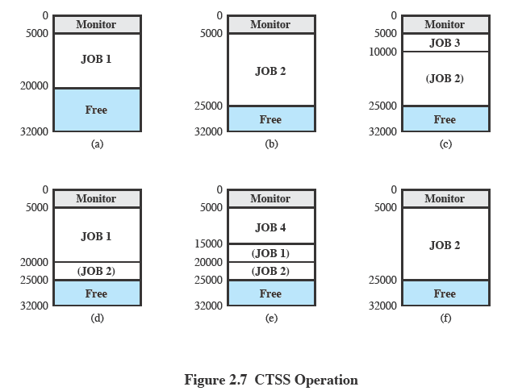
CTSS operation

Slide 34
Major advances
OS are some of the most complex pieces of software
Major advances in the development include
Processes
Scheduling and resource management
Memory management
Information protection and security
System structure

Slide 35
Process
A fundamental concept in operating system structure
A process is defined variously as
A program in execution
An instance of a running program
An entity that can be assigned to, and executed on a processor
A unit of activity characterized by a single sequential thread of execution. It has a state and necessary system resources allocated

Slide 36
Development of the Process
Three major lines of computer system development created problems in timing and synchronization that contributed to the development:
Multiprogramming batch operation
Processor is switched among the various programs residing in main memory
Time sharing
Be responsive to the individual user but be able to support many users simultaneously
Real-time transaction systems
A number of users are entering queries or updates against a database

Slide 37
Components of a process
A process consists of
An executable program
The associated data needed by the program
The execution context (or “process state”) of the program
The execution context
is the internal data by which the OS is able to supervise and control the process
Includes contents of the various process registers
Also includes information such as its priority and the state

Slide 38
Process Control Block
The execution context of each process is kept in a data structure, called Process Control Block (PCB)
New features can be designed and incorporated into the OS by expanding the context to include any new information needed to support the feature

Slide 39
Operating System as a Resource Manager
Process management
Load, execute, create, terminate, wait, signal, abort
Memory management
Allocate and free memory; virtual memory
I/O management
Request/release, read/write/position
File management
Create/delete, open/close, read/write/reposition, get/set file attributes
Protection and Security
Controlled access to system resources and information

Slide 40
OS Design goals
User goals
Convenient to use
Easy to learn
Reliable
Safe
fast
System goals
Easy to design, implement, and maintain
Flexible
Reliable
Error free and efficient

Slide 41
Mechanisms and policies
Mechanisms ➔ how?
Policies ➔ what?
Principle – separate mechanisms from policies
Allows maximum flexibility

Slide 42
Implementation
Traditionally Assembly Language
Now, mainly in higher level language
Can be written faster
More compact
Easier to understand and debug
Easy portability

Slide 43
OS Architecture
OS – large and complex
Common approach – partition into small components
Different approaches and design elements have been tried
Microkernel architecture
Object-oriented design

Slide 44
OS Structure
Simple
Original Unix
Limited structure
Two separable parts
Systems programs
Kernel
Unix Kernel consists of
Every thing below system-call interface and above the physical hardware
Includes file system, CPU scheduling, MM, and other OS functions

Slide 45
Layered approach
Divided into a number of layers
Each layer uses the functions and services of layers below it.

Slide 46
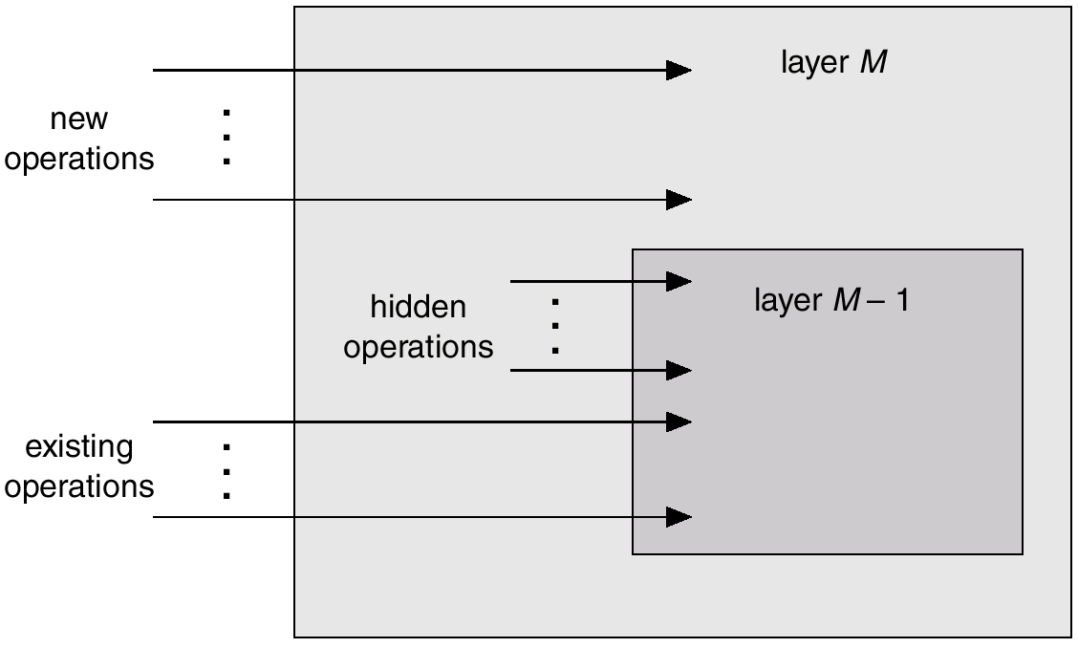
An OS Layer

Slide 47
Microkernel architecture
Keep kernel small
Assigns only few essential functions to the kernel
Communication – uses message passing
Advantages
Easier to extend
Easier to port
More reliable
More secure
Well-suited to distributed environment

Slide 48
Objected-oriented design
Object-oriented programming approach
Consists of a
Set of core components
Services linked dynamically as needed
Example – Solaris
Advantages:
Enables programmers to customize an OS without disrupting system integrity
Eases the development of distributed tools and full blown distributed operating system

Slide 49
Virtualization
Enables a computer to simultaneously run multiple operating systems or multiple sessions of a single OS
Allows applications for different OSs to be run on a single platform
A host operating system can also support one or more other machines -- virtual machines (VMs), i.e. a virtual machine that has the characteristics of whatever hardware platform it is supporting. This virtual machine can also have any operating system
Makes it possible to deal with legacy applications

Slide 50
Virtual Machine Concept
Virtual Machine 1
Virtual Machine 2
VMM
Host OS
Hardware
Virtual Machine n

Slide 51
Virtual Machine Architecture
Process Perspective
Application Perspective
Operating System Perspective

Slide 52
The Process Perspective
The machine on which a process executes consists of
the virtual memory space assigned to the process
the processor registers it may use
the user-level machine instructions it may execute
OS system calls it may invoke for I/O
The application binary interface (ABI) defines the machine as seen by a process
Note: ABI defines the system call interface to the OS and the hardware resources and the services available in a system through the instruction set architecture (ISA)

Slide 53
The Application Perspective
machine characteristics are specified by high-level language capabilities and OS system library calls
API defines the machine for an application

Slide 54
The Operating System Perspective
For OS, the machine hardware defines the system that supports operations of the system.
The processes share file system and other I/O resources
system allocates real memory and I/O resources to the processes
The instruction set architecture (ISA) provides the interface between the system and machine

Slide 55
Implementation of VMs
Two approaches
Process virtual machine
System virtual machine

Slide 56
Process Virtual Machines
A process VM presents an ABI to an application process, translates a set of OS and user-level instructions composing one platform to those of another.
A process VM is a virtual platform for executing a single process.
The process VM is created when the process is created and terminated when the process is terminated.

Slide 57
Process virtual machine
Cross-platform portability is provided by implementing the process VM as part of an overall HLL application environment.
The ABI does not correspond to any specific machine
ABI designed to support a given HLL
ABI easily portable to different ISAs
The HLL VM includes a compiler to generate binary code that can be executed/interpreted on any machine that has the process VM implemented
Example: JAVA VM architecture, Microsoft Common Language Infrastructure

Slide 58
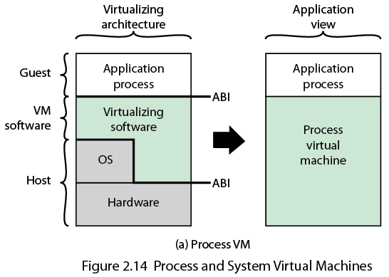
Process and System Virtual Machines
Notes:
In essence, a process VM presents an ABI to an
application process, translates a set of OS and user-level instructions composing one
platform to those of another ( Figure 2.14a ). A process VM is a virtual platform for
executing a single process. As such, the process VM is created when the process is
created and terminated when the process is terminated.
In order to provide cross-platform portability, a common implementation of
the process VM architecture is as part of an overall HLL application environment.
The resulting ABI does not correspond to any specific machine. Instead, the ABI
specification is designed to easily support a given HLL or set of HLLs and to be easily
portable to a variety of ISAs. The HLL VM includes a front-end compiler that
generates a virtual binary code for execution or interpretation. This code can then
be executed on any machine that has the process VM implemented.
Two widely used examples of this approach are the Java VM architecture and
the Microsoft Common Language Infrastructure, which is the foundation of the
.NET framework.

Slide 59
System Virtual Machine
The virtualizing software translates the ISA used by one hardware to another
There is no separate host OS – instead, the host system OS incorporates the VM capability.
The virtualizing software is host to a number of guest Oss
Each virtual machine includes its own OS
A single hardware platform can support multiple guest OS environments simultaneously
Benefits: application portability, legacy systems support, security

Slide 60
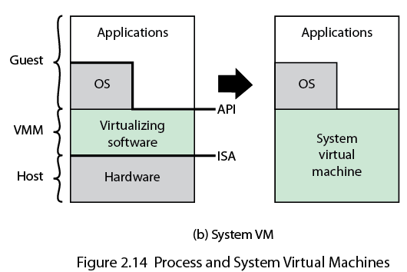
System Virtual Machines

Slide 61
SMP Operating System
Provides all the functionality of a multi-programming system plus additional features to accommodate multiple processors

Slide 62
Key Design Issues
Simultaneous concurrent processes or threads
The kernel routines need to be reentrant to allow several processors to execute the same kernel code simultaneously
Scheduling
any processor may perform scheduling, which complicates the task of enforcing a scheduling policy
Synchronization
with multiple active processes having potential access to shared address spaces or shared I/O resources, care must be taken to provide effective synchronization
Memory management
the reuse of physical pages is the biggest problem of concern
Reliability and Fault Tolerance
the OS should provide graceful degradation in the face of processor failure

Slide 63
Multicore OS
The design challenge for a multicore system is to efficiently harness the multicore processing power and intelligently manage the substantial on-chip resources efficiently
Potential for parallelism exists at three levels:
hardware parallelism within each core processor, known as instruction level parallelism
potential for multiprogramming and multithreaded execution within each processor
potential for a single application to execute in concurrent processes or threads across multiple cores

Slide 64
Parallelism within applications
Most applications can be split into multiple tasks that can be executed in parallel
Developer must decide what pieces can or should be executed simultaneously or in parallel

Slide 65
Virtual Machine Approach
Allows one or more cores to be dedicated to a particular process and then leave the processor alone to devote its efforts to that process
Multicore OS could then act as a hypervisor that makes a high-level decision to allocate cores to applications but does little in the way of resource allocation beyond that

Slide 66
Summary
Operating system objectives and functions:
convenience, efficiency, ability to evolve
user/computer interface
resource manager
Evolution
serial processing, simple batch systems, multiprogrammed batch systems, time sharing systems
Process
Memory management
Scheduling and resource management
Symmetric multiprocessing (SMP)
Virtual machines

